Slide 1
TRIM3D DOC
By zxt

Slide 2
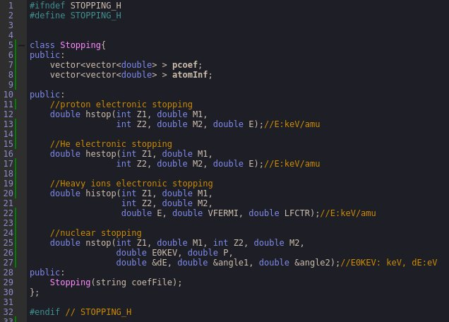
Stopping Class(stopping.cpp, stopping.h)

Slide 3
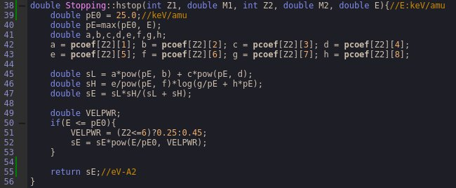
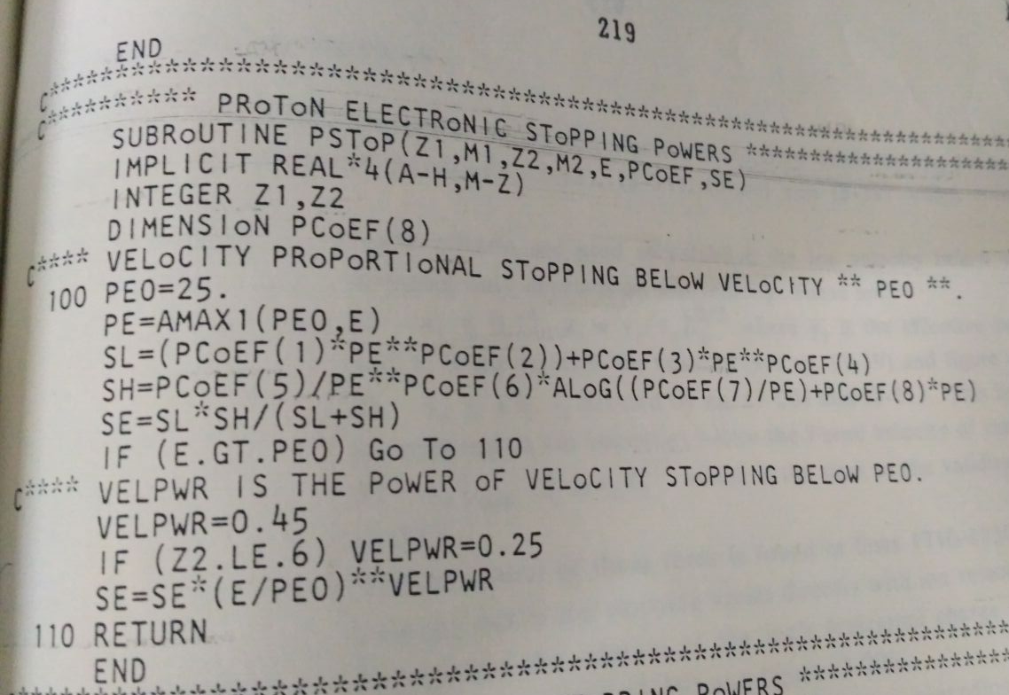
Stopping Class(stopping.cpp, stopping.h)

Slide 4

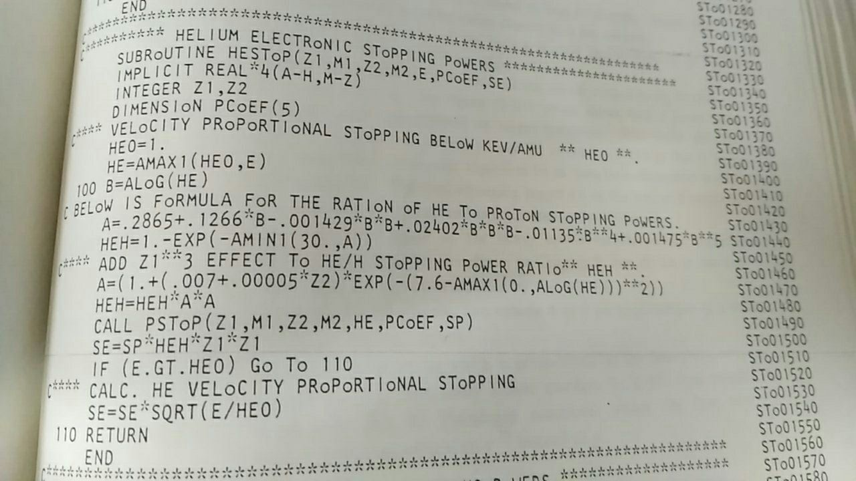
Stopping Class(stopping.cpp, stopping.h)

Slide 5
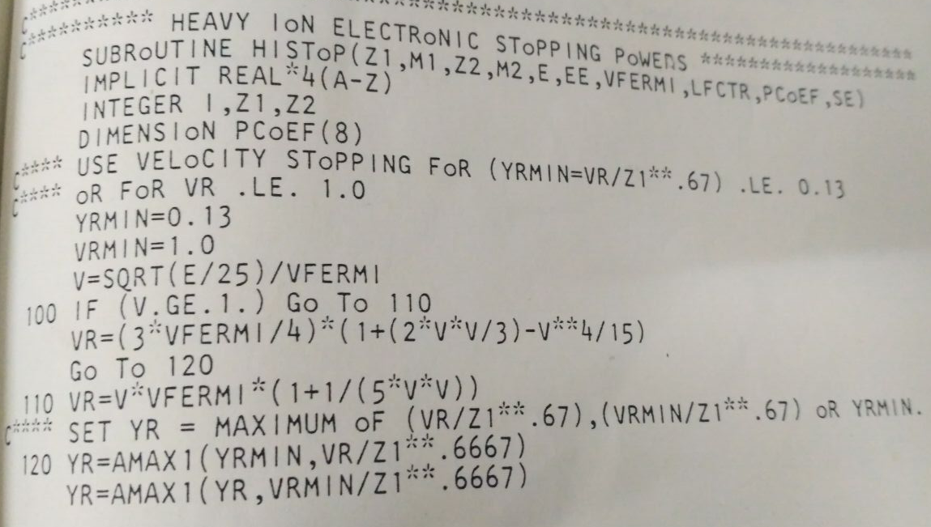
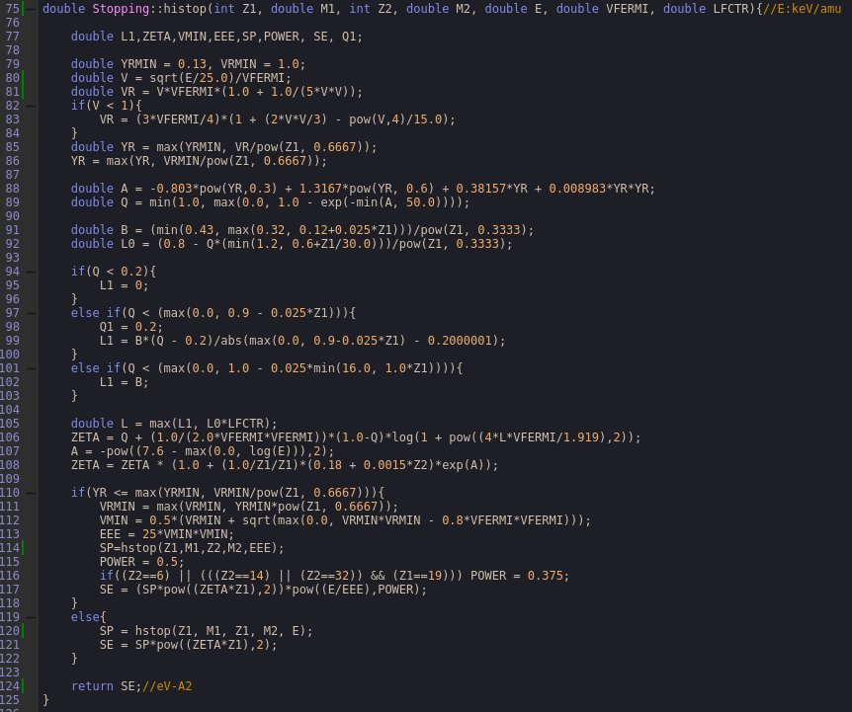
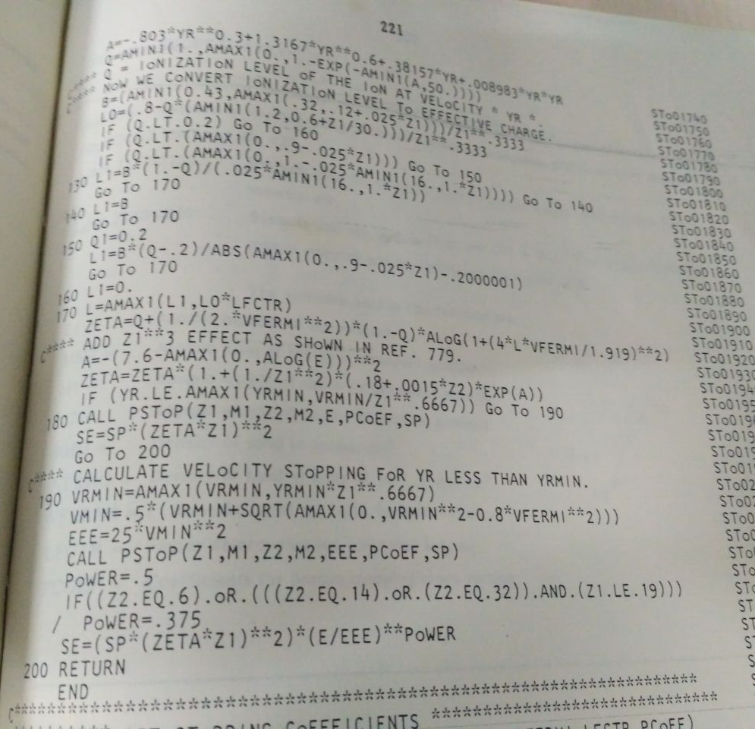
Stopping Class(stopping.cpp, stopping.h)

Slide 6
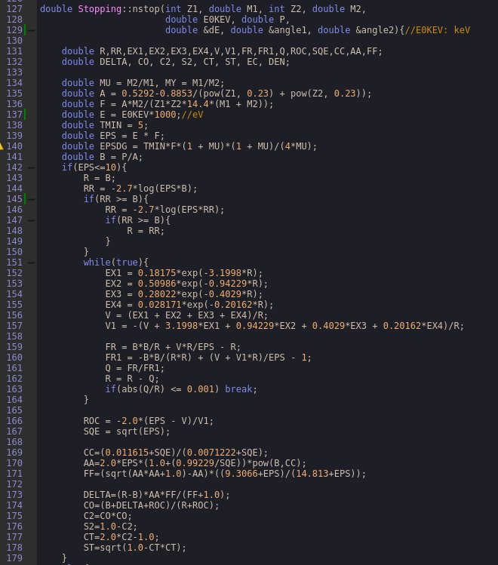
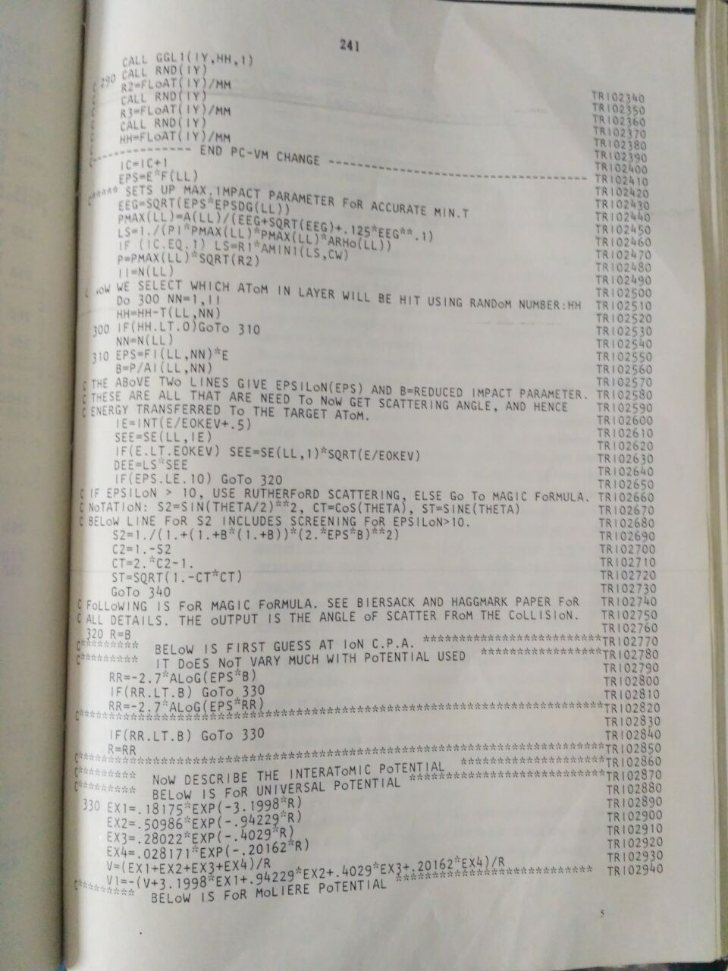
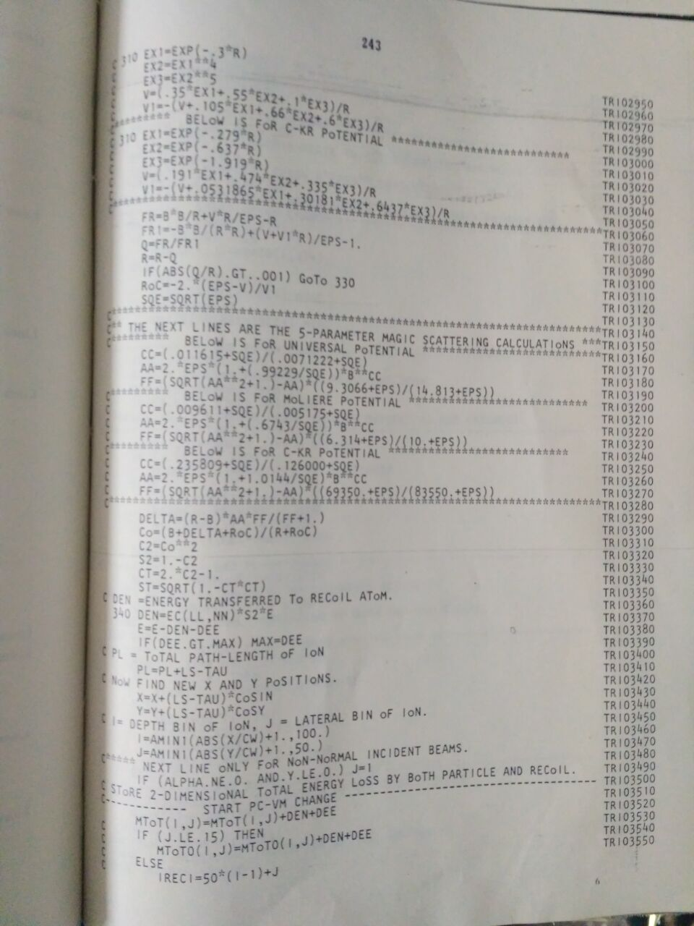
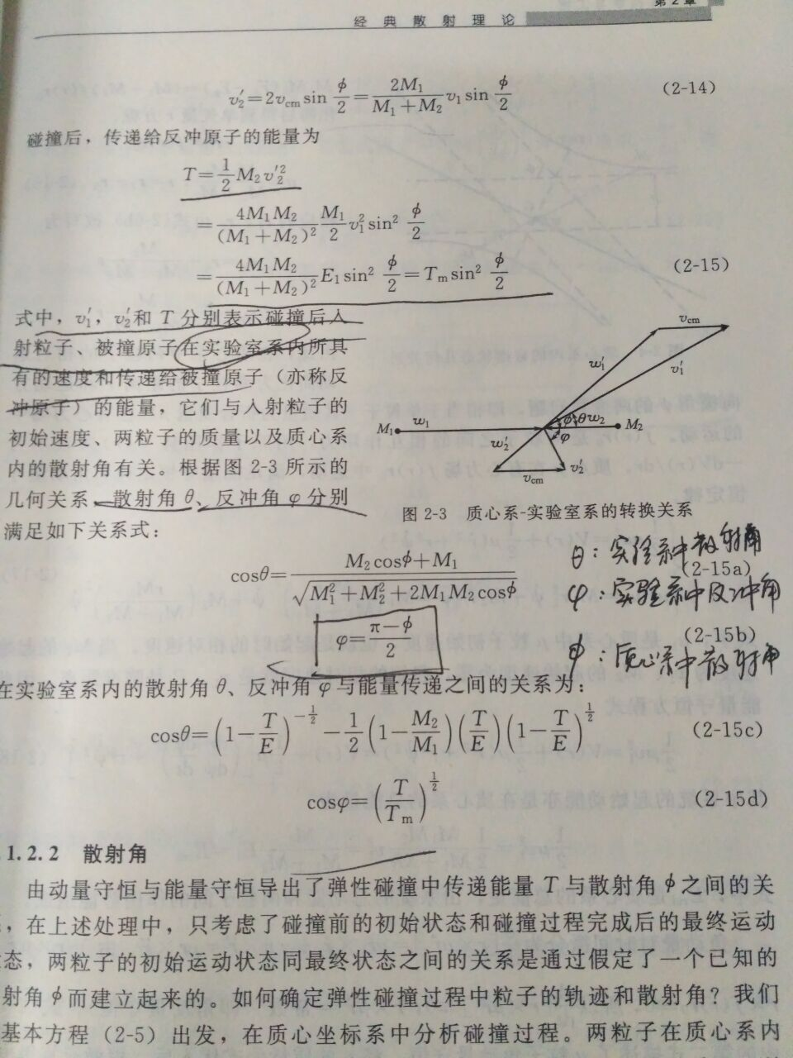
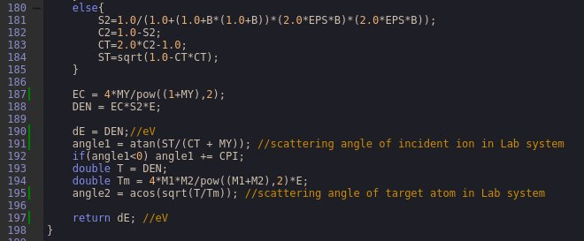
Stopping Class(stopping.cpp, stopping.h)

Slide 7
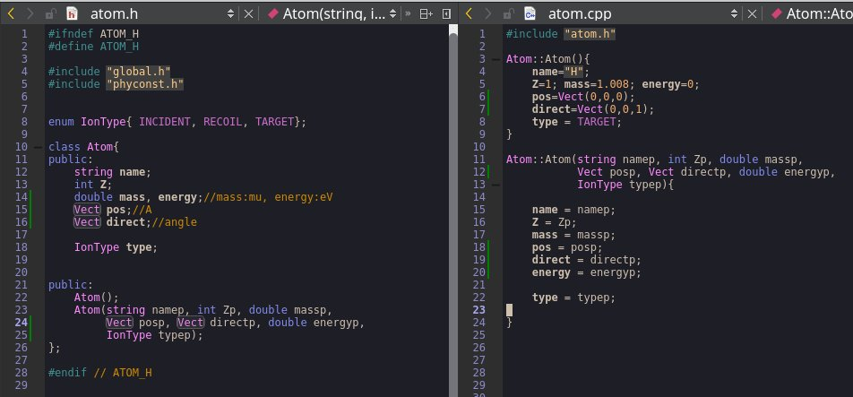
Atom Class
direct is a unity vector of direction of velocity. x is cos(angle of vx to x axis) …

